Slide 1
Pediatric vs Adult Dengue Severity Prediction with Subgroup-Specific SHAP Explanations
Mohammad Mazharul Alam
Roll No: 22070116
&
Md. Aftabul Islam
Roll No: 22070103
Under the guidance of
Mohammad Arif Hasan Chowdhury
Assistant Professor,
Department of CSE,FSET,USTC
Department of Computer Science and Engineering
University of Science and Technology Chittagong (USTC)
Foy’s Lake, Khulshi, Chattogram -4202
Bangladesh
16th August 2026

Slide 2
Overview
Background & Introduction
Objectives
Problem Statement
Related Works
Proposed Methodology
Results & Discussion
Conclusion & Future Work
References

Slide 3
Background
Dengue severity models are usually trained on pooled, all-age cohorts - masking how children and adults actually differ.
Why
Pediatric and adult dengue patients show different physiology - plasma leakage, comorbidities, hemorrhagic patterns.
What is missing
Most ML studies use a single pooled model and a single global SHAP summary. No dengue study quantitatively compares SHAP feature attribution between pediatric and adult subgroups.
What we have done
Age-stratified models + subgroup SHAP + an early-stage risk-assessment dashboard.

Slide 4
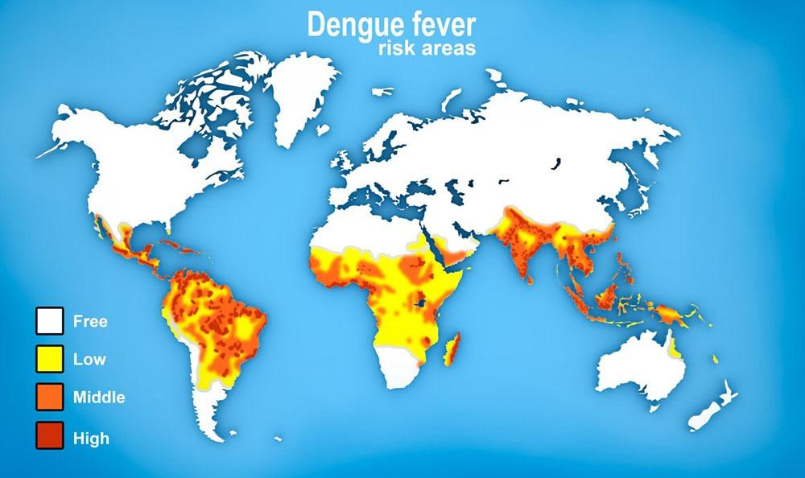
Introduction
Why this matters ?
Dengue is a mosquito-borne viral infection (Aedes aegypti, Aedes albopictus) and a major public health burden across tropical and subtropical regions.
Early identification of patients likely to progress to severe disease is critical for timely fluid management and supportive care.

Slide 5
Introduction
Pooled-model assumption : Most prior ML work treats age as just one input feature, not a stratification variable.
Clinical reality : Children show higher rapid plasma leakage; adults show more comorbidities and hemorrhagic signs.
Our thesis position : Compare pooled vs. age-stratified models and their SHAP explanations directly, then expose the result via a dashboard.

Slide 6
Problem Statement
Age-pooled model training: Classifiers are typically trained on pooled pediatric + adult data, assuming one feature–severity relationship fits all ages.
Global feature attribution: SHAP explanations are computed for the whole pooled cohort, averaging out subgroup-level differences.
Research question
Do subgroup-trained models and their SHAP explanations differ meaningfully from an age-pooled baseline for dengue severity prediction -and can that difference be made usable through a dashboard?
Misalignment with clinical practice: Clinicians judge children and adults against age-specific norms; pooled models give one generic boundary.
Lack of explainable deployment: Trained models are rarely wired into a system that supports patient-level explanation or structured data collection.

Slide 7
Objectives
1. Develop pediatric, adult, and pooled ML models for severe-dengue prediction using classifiers.
2. Generate subgroup-specific SHAP explanations, identify model-derived feature splits
3. An explainable web dashboard for longitudinal data collection.

Slide 8
Related Works
Ref | Focus | Cohort | Methods | Outcome Definition | Gaps
[1] | Early-phase dengue diagnosis | Decision-tree algorithms | Diagnosis + outcome(early illness) | Diagnosis + outcome(early illness) | Age-aware but pre-SHAP; no subgroup specific explain-ability
[2] | Pediatric severity using early labs | Thailand, pediatric cohort | Logistic ML (misclassification cost ratio 1:10) | Dengue severity from early labs | Pediatric only; no adult comparison subgroup
[3] | Clinical pattern discovery | Brazil, n=527 | K-means+hierarchical clustering | Clinical phenotypes (not WHO severity) | Age identified as top discriminator; no subgroup specific prediction

Slide 9
Related Works
Ref | Focus | Cohort | Methods | Outcome Definition | Gaps
[4] | Demographics + lab ML | Taiwan, n=798 (138 severe | ANN, RF,GBM,SVM,LR+SHAP | Severe dengue (binary | ANN AUC ~ 0.83; pooled cohort, global SHAP only
[5] | Stacking ensemble + SHAP | Mixed, 17 features | 11 ML models + Staking + SMOTE | Severe dengue | 77% baseline / 83% post-SMOTE accuracy; global SHAP only
[6] | Stacked ensemble + dual XAI | Bangladesh, n=1523 | Stacked ensemble + SMOTEENN + SHAP/LIME | Dengue severity (multiclass) | 96.38% accuracy; global explanation only

Slide 10
Related Works
Ref | Focus | Cohort | Methods | Outcome Definition | Gaps
[7] | SHAP-based factor analysis | Vietnam+Bangladesh | XGBoost+SHAP plots | WHO severity classes | Global SHAP only; no age-conditioned explanation
[8] | Hematology driven severity | Public dataset n=1450 | LR,RF,SVM, CGBoost +SHAP | WHO severity classes | XGBoost macro-F1 = 0.59; global SHAP
[9] | Optimized feature diagnosis | Mixed, RFE selected features | RF + RFE + SHAP + LIME | Dengue diagnosis/severity | RF 99.67% accuracy; global XAI

Slide 11
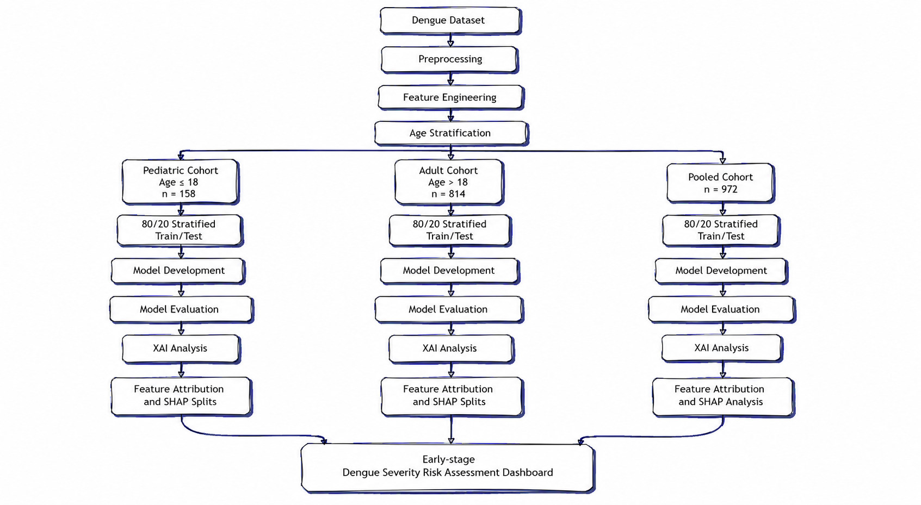
Proposed Methodology
Figure: Workflow overview

Slide 12
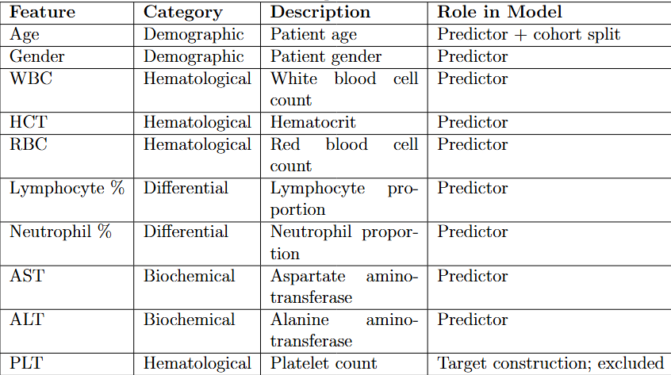
Methodology: Data Preparation
Dataset Collection: Comprehensive Dengue Hematology and Clinical Dataset from Bangladesh for Machine Learning and Diagnostic Research [10]
9 🡪 Core clinical/demographic predictors (WBC, HCT, RBC, Lymph %, Neut %, AST, ALT, Age, Gender)
972 🡪 Total NS1-positive records (from 1,329 raw records)
158 / 814 🡪 Pediatric (≤18y) / Adult (>18y) split
80:20 🡪 Stratified train/test split, random_state = 42

Slide 13
Methodology: Model & Evaluation
5 classifiers per cohort: Logistic Regression, Random Forest, XGBoost, LightGBM, Stacking Ensemble (LR meta-learner).
Metrics: Accuracy, AUC-ROC, Sensitivity, Specificity, F1, Matthews Correlation Coefficient (MCC).
Explainability: SHAP TreeExplainer on best performed model; depth-1 decision trees fitted to SHAP>0 values to extract feature splits; Kendall's τ-b for pediatric–adult rank comparison.

Slide 14
Methodology: Dashboard development
Programming Languages
Javascript
Python
Stack used
Frontend: ReactJs
Backend: FastApi + Cohort specific best performed models
Database: PostgreSQL

Slide 15
Result - Model Performance Summary
Cohort | Best Model | AUC-ROC | Accuracy | Sensitivity | Specificity | F1-Score | MCC
Pediatric (≤18) | Random Forest | 0.961 | 90.6% | 66.7% | 100.0% | 0.800 | 0.768
Pediatric (≤18) | Stacking Classifier | 0.947 | 90.6% | 66.7% | 100.0% | 0.800 | 0.768
Pediatric (≤18) | XGBoost | 0.899 | 84.4% | 77.8% | 87.0% | 0.737 | 0.628
Adult (>18) | Random Forest | 0.892 | 84.7% | 78.1% | 90.0% | 0.820 | 0.690
Adult (>18) | Stacking Classifier | 0.882 | 83.4% | 79.5% | 86.7% | 0.811 | 0.664
Adult (>18) | XGBoost | 0.856 | 78.5% | 79.5% | 77.8% | 0.768 | 0.570

Slide 16
Result - Cohort Specific Selected Model
Cohort | Best Model | Accuracy | AUC | F1 | MCC
Pediatric | Stacking / Random Forest | 90.6% | 0.947 / 0.961 | 0.800 | 0.768
Adult | Random Forest | 84.7% | 0.892 | 0.820 | 0.690
Pooled | Random Forest | 79.0% | 0.860 | 0.739 | 0.566

Slide 17
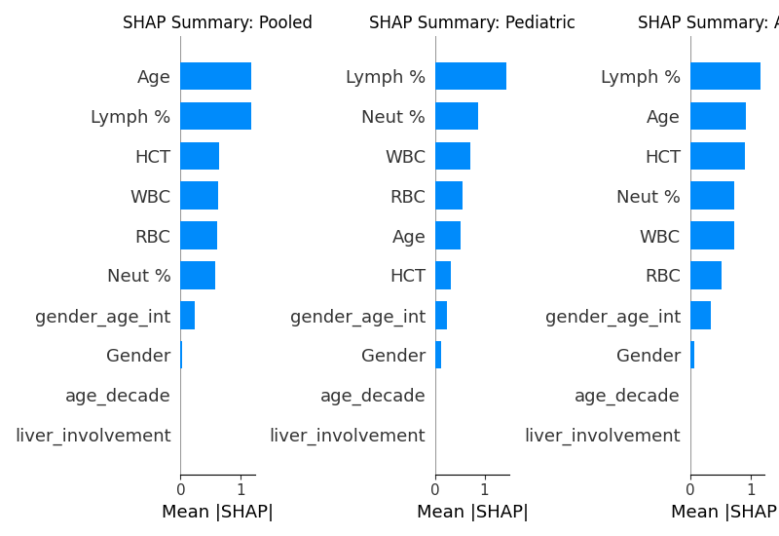
Result - SHAP Feature Attribution

Slide 18
Result - Model-Derived SHAP Feature Splits
TWO-COLUMN COMPARISON
PEDIATRIC SPLITS (SHAP > 0)
Lymphocyte % - split at > 44.50%
Neutrophil % - split at ≤ 48.00%
WBC - split at ≤ 4.34 × 10³/µL
ADULT SPLITS (SHAP > 0)
Lymphocyte % - split at > 24.99%
HCT - split at > 40.65%
Age - split at > 31.00 years

Slide 19
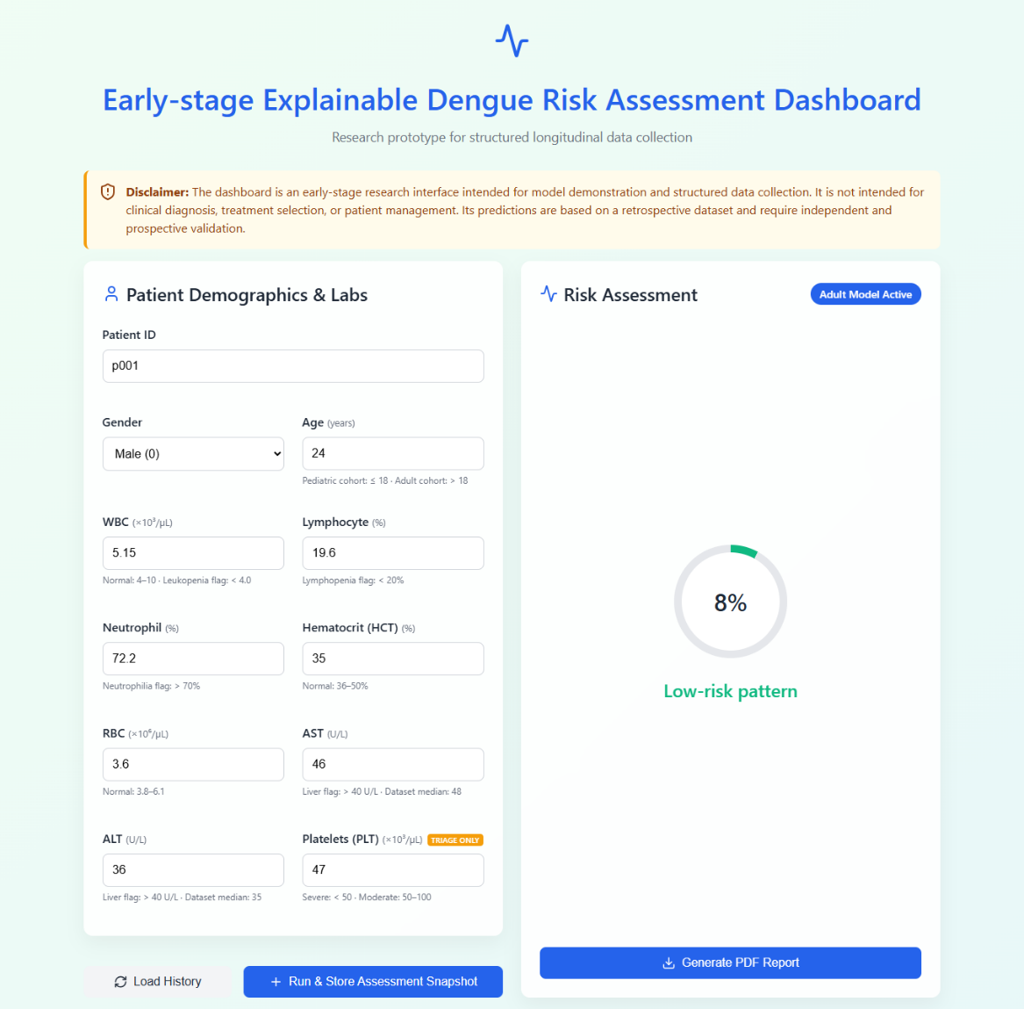
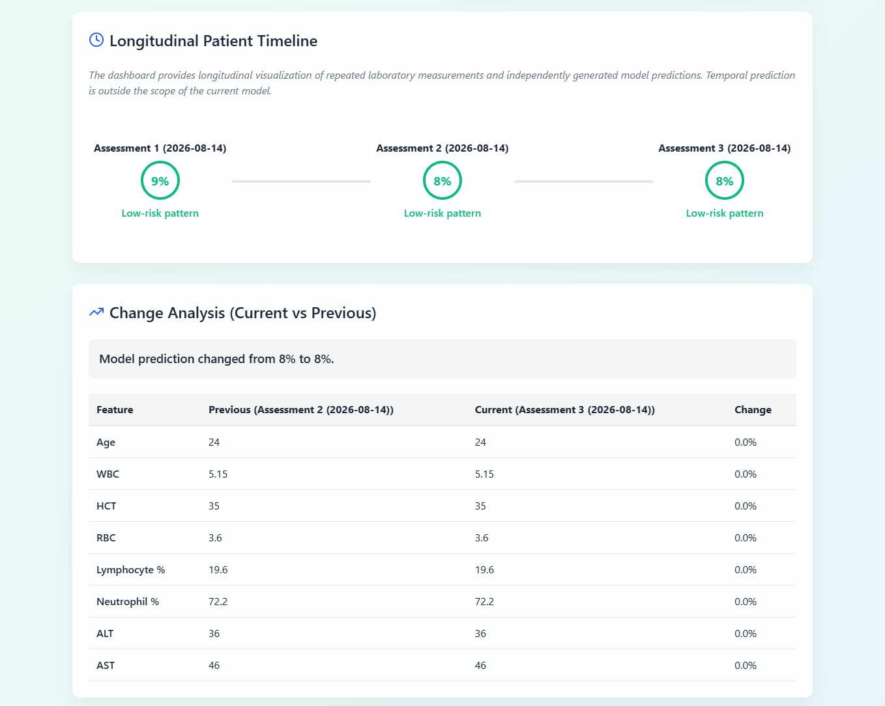
Result - Web Application

Slide 20
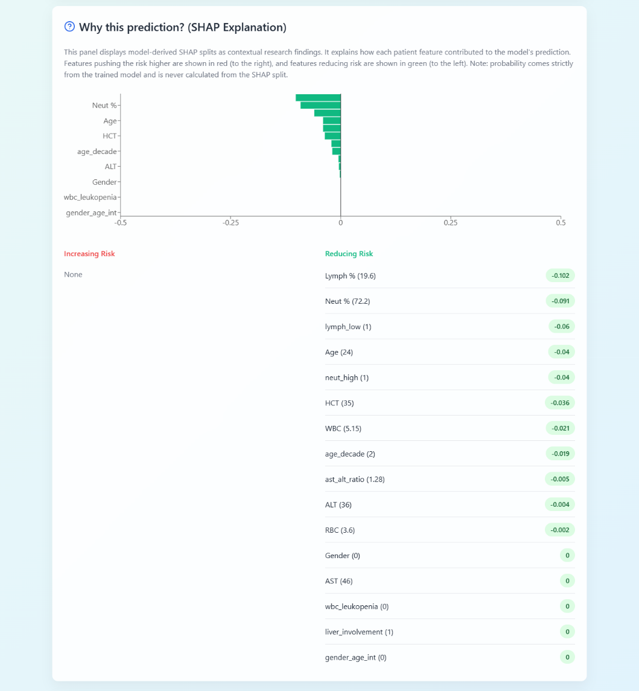
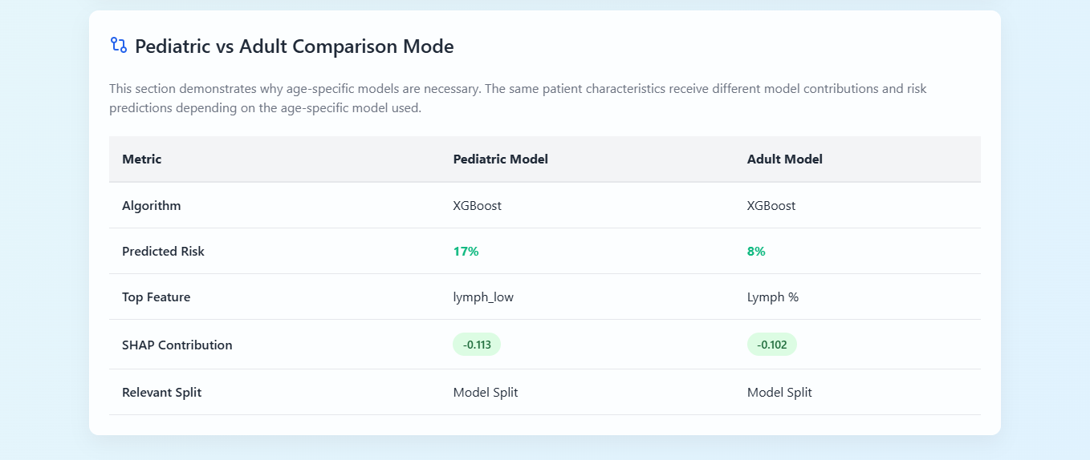
Result-Web Application

Slide 21
Conclusion & Future Work
Age-stratified models outperformed the pooled baseline (pediatric: 90.6% accuracy / AUC 0.947 Stacking; adult: 84.7% accuracy / AUC 0.892 Random Forest). SHAP rankings were highly correlated across age groups (τ-b = 0.900), yet model-derived feature-split thresholds differed meaningfully by age - confirming that pooled models can mask clinically relevant, age-specific decision behavior.
FUTURE WORK
External, prospective validation on independent, geographically distinct datasets
Larger pediatric cohort to strengthen subgroup robustness
WHO-adjudicated severity labels in place of the PLT-derived proxy
Dashboard-driven longitudinal data collection enabling future temporal/sequential modeling (e.g., RNNs)

Slide 22
References
[1] L. B. Tanner et al., ”Decision Tree Algorithms Predict the Diagnosis and Outcome of Dengue Fever in the Early Phase of Illness,” PLOS Neglected Tropical Diseases, 2008.
[2] J. A. Potts et al., ”Prediction of Dengue Disease Severity among Pediatric Thai Patients Using Early Clinical Laboratory Indicators,” PLOS Neglected Tropical Dis eases, vol. 4, no. 8, p. e769, 2010.
[3] S. Rajapakse et al., ”Clinical features of dengue in adults and children: A compar ative study,” Transactions of the Royal Society of Tropical Medicine and Hygiene, vol. 108, no. 1, pp. 24-29, 2014
[4] S.-W. Huang et al., ”Assessing the risk of dengue severity using demographic infor mation and laboratory test results with machine learning,” PLOS Neglected Tropical Diseases, vol. 14, no. 12, p. e0008960, 2020.
[5] A. K. M. Masum et al., ”Enhancing Dengue Fever Diagnosis: A Machine Learning Framework with Stacking Ensemble and SHAP Explainability,” IEEE QPAIN, 2025. [15] I. A. Tuhin et al., ”An interpretable machine learning model for dengue detection with clinical hematological data,” Healthcare Analytics, 2025.

Slide 23
References
[6] I. A. Tuhin et al., ”An interpretable machine learning model for dengue detection with clinical hematological data,” Healthcare Analytics, 2025.
[7] S. U. Chowdhury et al., ”Shapley-Additive-Explanations-Based Factor Analysis for Dengue Severity Prediction,” Journal of Imaging, vol. 8, no. 9, p. 229, 2022.
[8] M. Niazi and S. Momand, ”Dengue Severity Level Prediction Using Hematology Driven Machine Learning Models,” Scientific Journal of Engineering, and Technol ogy, vol. 3, no. 1, 2026.
[9] K. Das et al., ”Optimized Feature-Driven Dengue Diagnosis Using Explainable Ma chine Learning Approaches,” IEEE QPAIN, 2025
[10] Thakur, Amonika; Nasrin, Sonia (2025), “Comprehensive Dengue Hematology and Clinical Dataset from Bangladesh for Machine Learning and Diagnostic Research”, Mendeley Data, V4, doi: 10.17632/jsbmtk8hty.4

